Slide 1
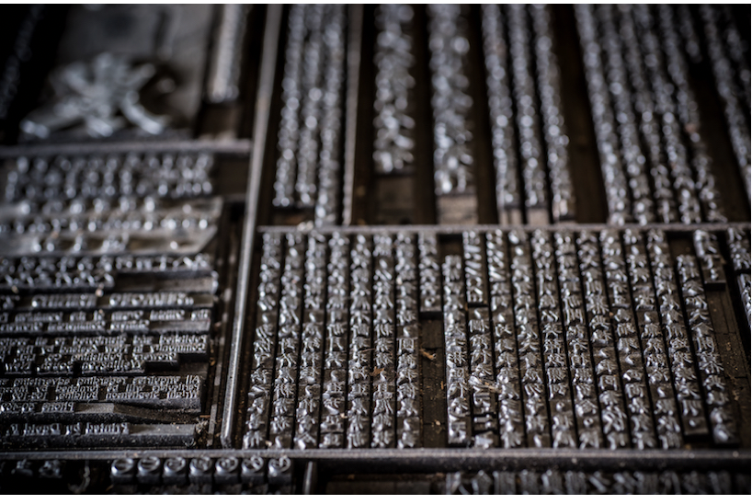
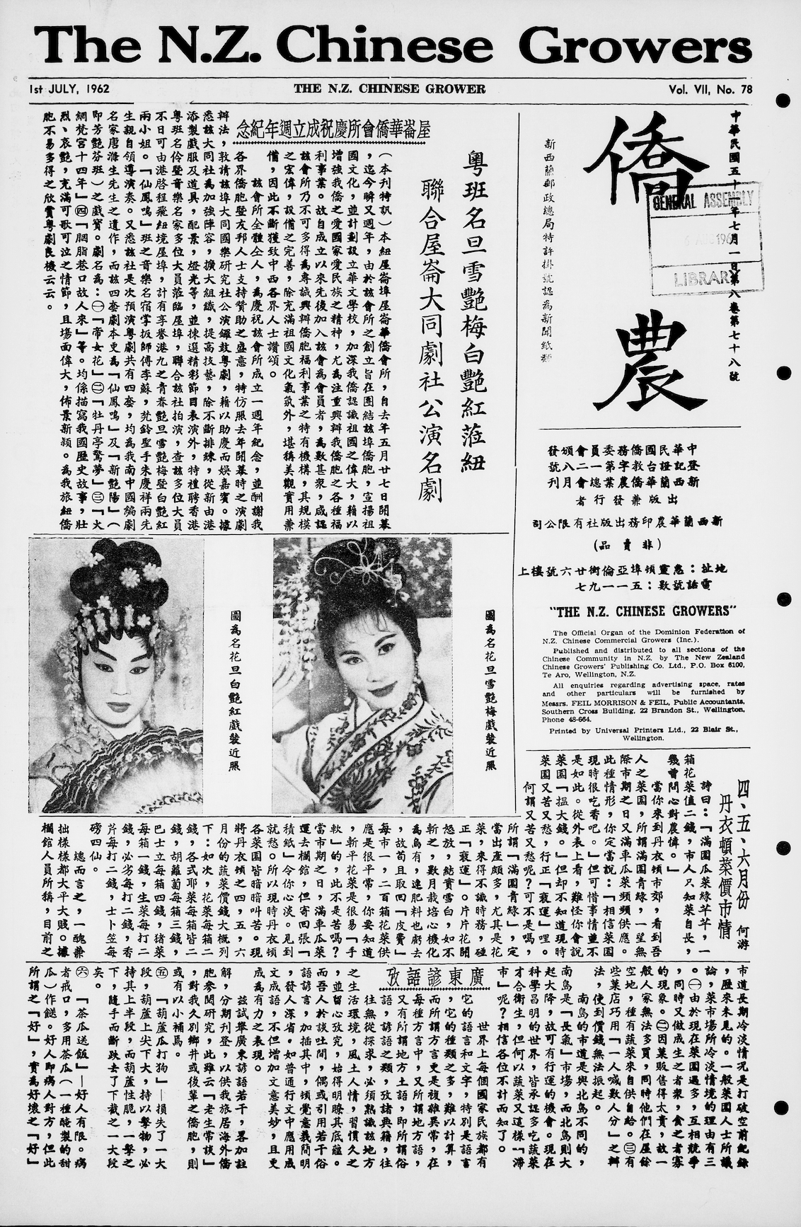
Machine Learning for Reading Full Form Chinese Characters in Historical NZ Newspapers
Waiteata Press | Chinese Scholar’s Studio | Type Restoration | OCR for Novel Texts
Overview
In 2016, The Wai-te-ata Press a letterpress printery, accepted the transfer of kaitiakitanga of New Zealand's only surviving Chinese language printing typeface collection used to print the New Zealand Chinese Growers Monthly Journal from 1952-1972
Incredibly significant for the Chinese community
Linked market gardeners around the country
Published local and international news
Shared traditional recipes, remedies and medicine
Problem –
Corpus is only useful if digitised with OCR to enable efficient navigation for further scholarly study
OCR is difficult for historical text as modern classifiers are not optimised to handle their intricacies
Obtaining training data is time consuming and unpractical
Solution –
Clustering to group characters through feature similarity
Display in an image grid to user in a human-in-the-loop solution for efficient filtering (semi-supervised learning)
ENGR489 | Waiteata Press | Marcus Frean | Charlene Leong

Slide 2
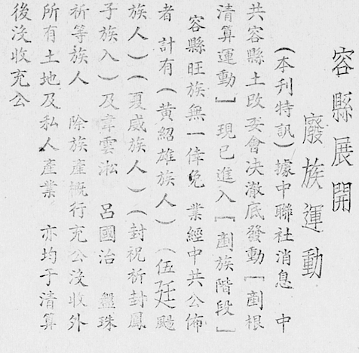
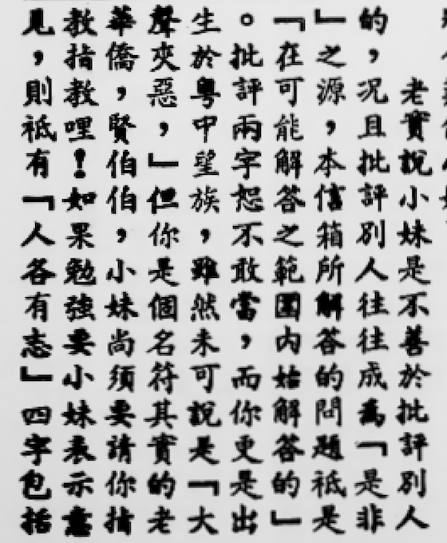
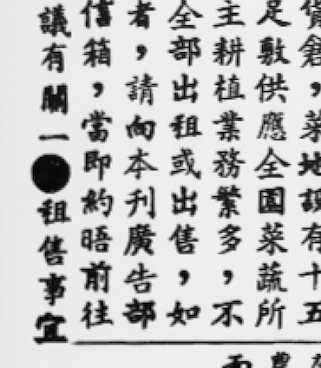
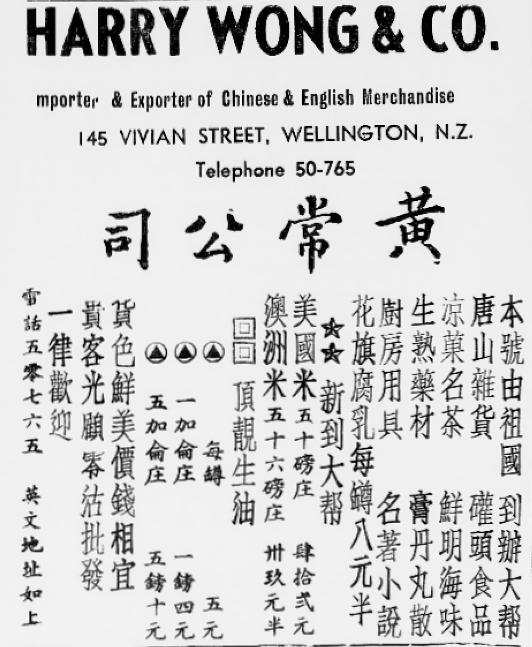
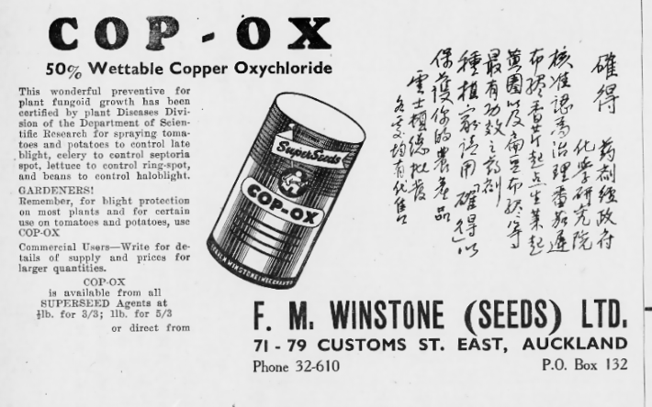
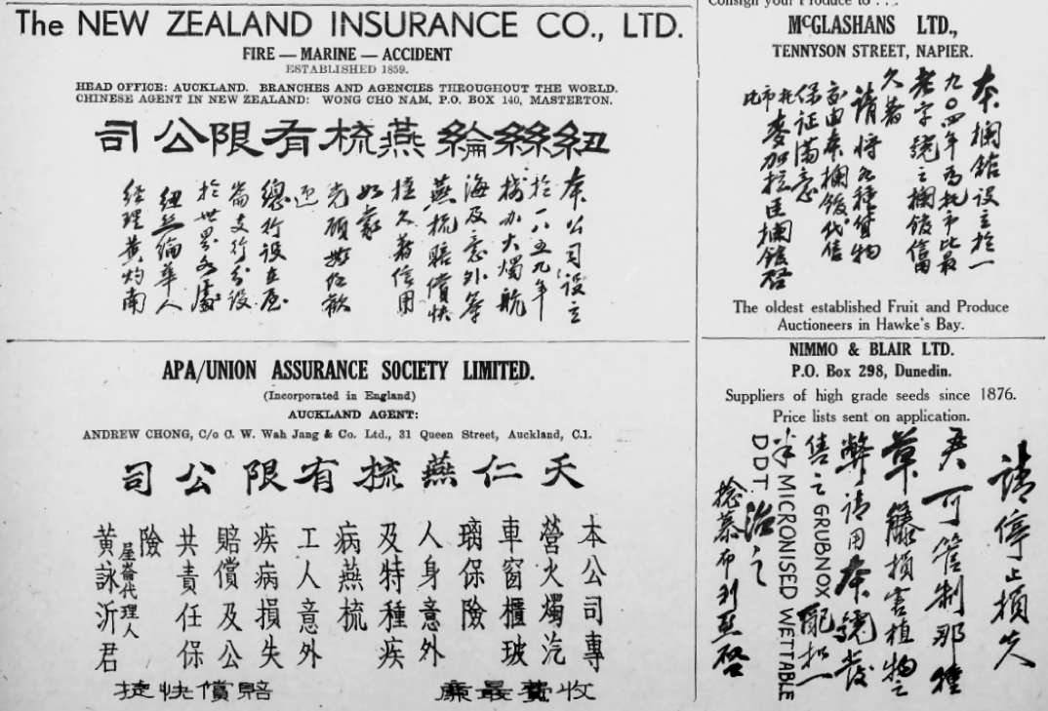
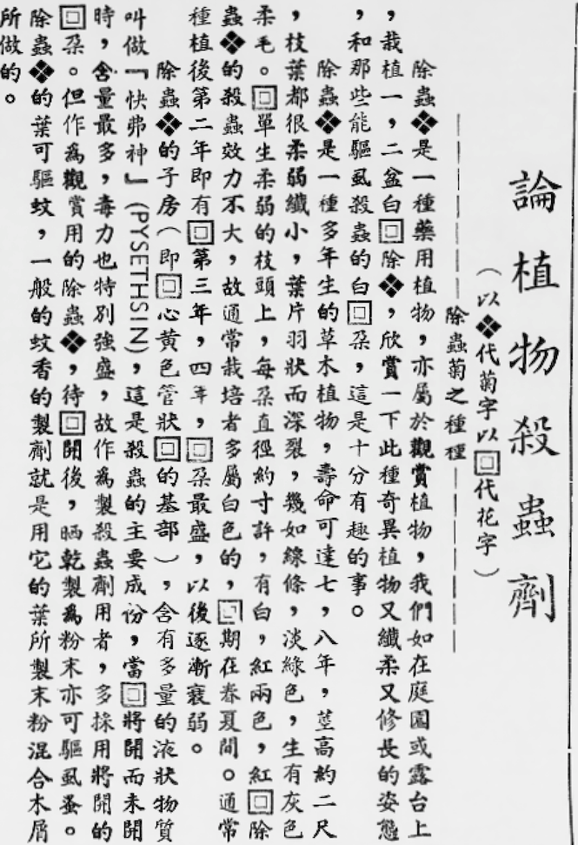
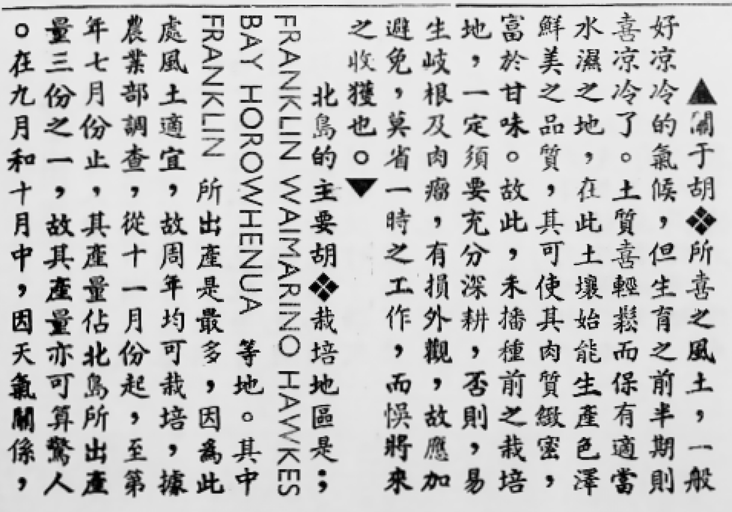
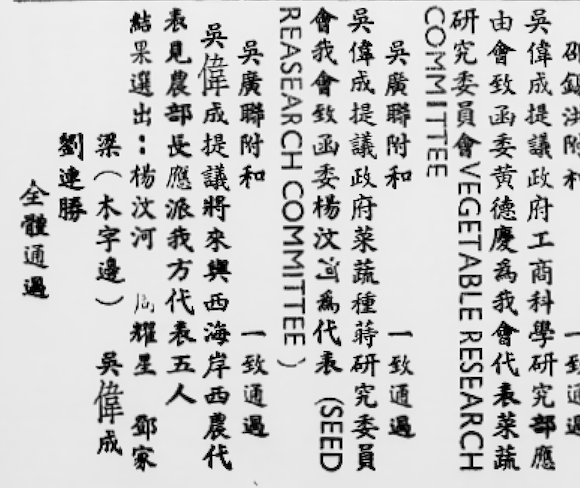
Problem Overview
Why OCR for Historical Texts (New Zealand Chinese Growers Monthly Journal) is Difficult
Faded Inking
Deterioration of Type
Disfigured Text
Deterioration
Calligraphy Characters
Filler Characters
Varying Fonts
Varying Text Direction due to English-Chinese Text
Traditional Chinese – top-down, right-left
English ads – left-right, top-down

Slide 3
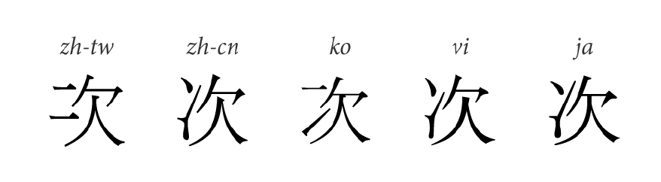
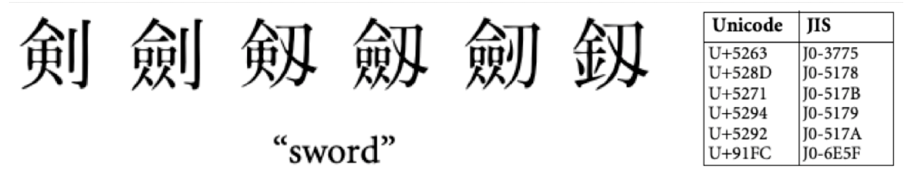
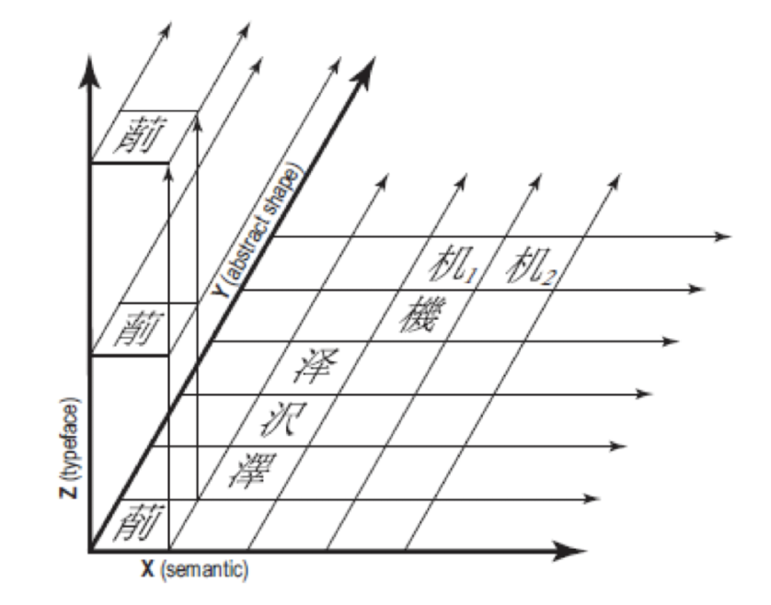
Problem Overview
Why OCR for Historical Texts (New Zealand Chinese Growers Monthly Journal) is Difficult
Han Unification Between Chinese, Japanese and Kanji Characters
Character Variants
Source Separation
3D Conceptual Model

Slide 4
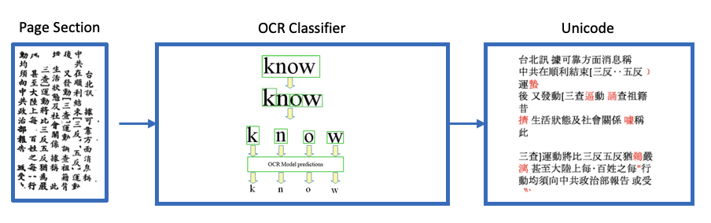
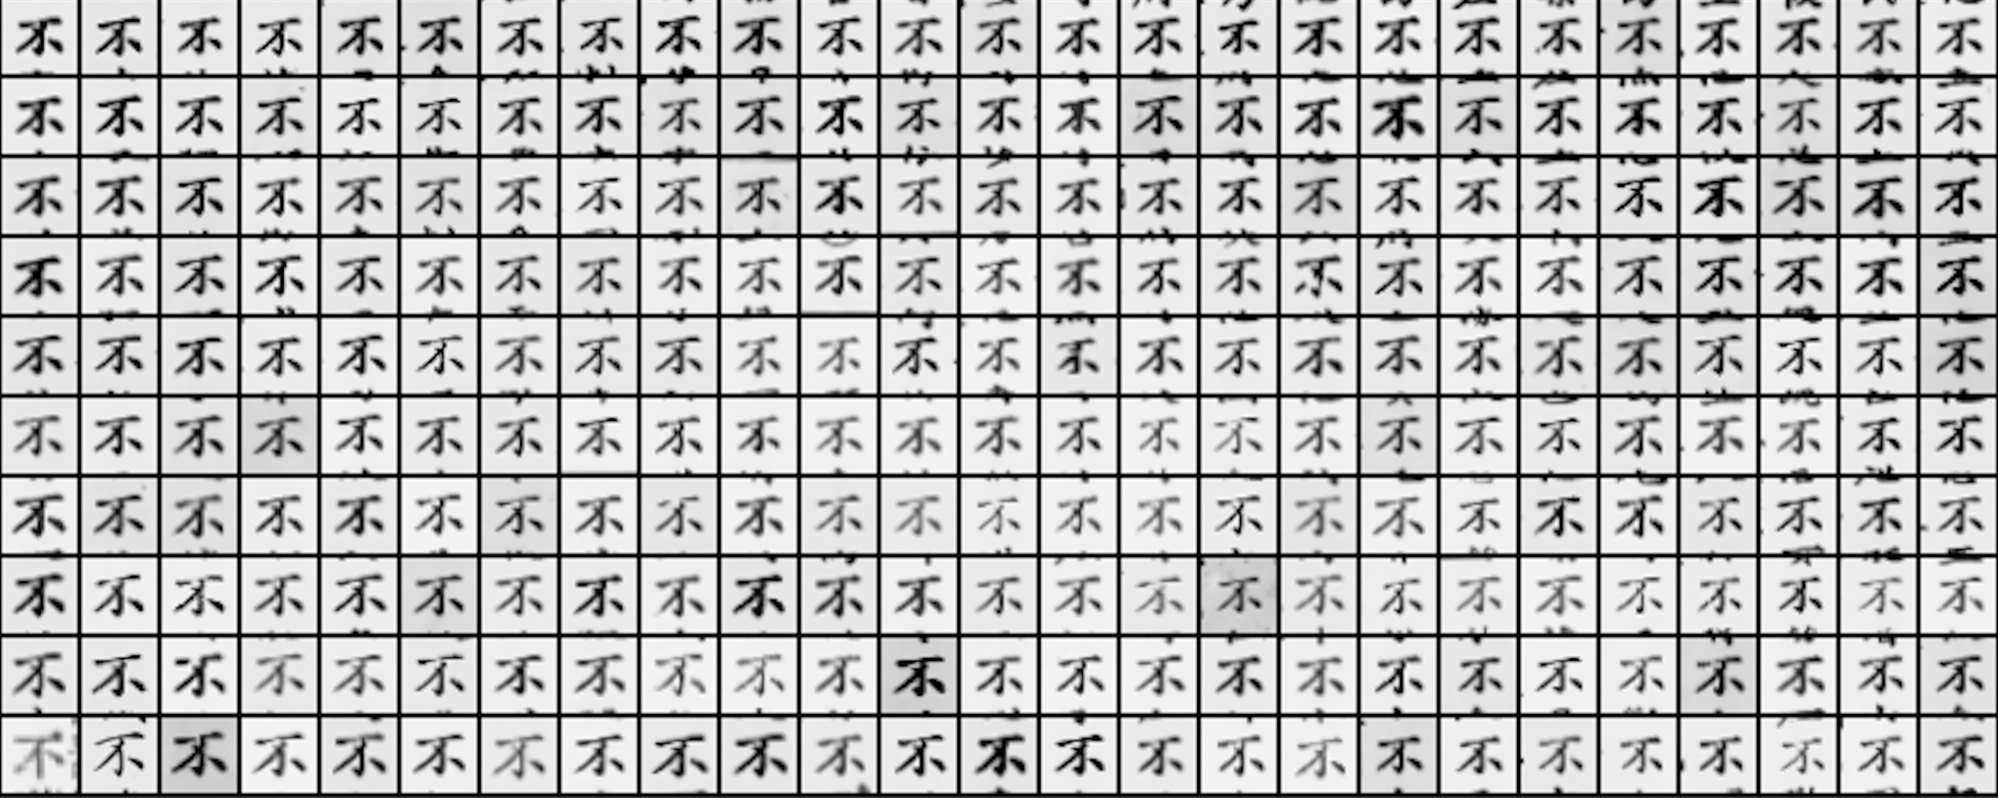
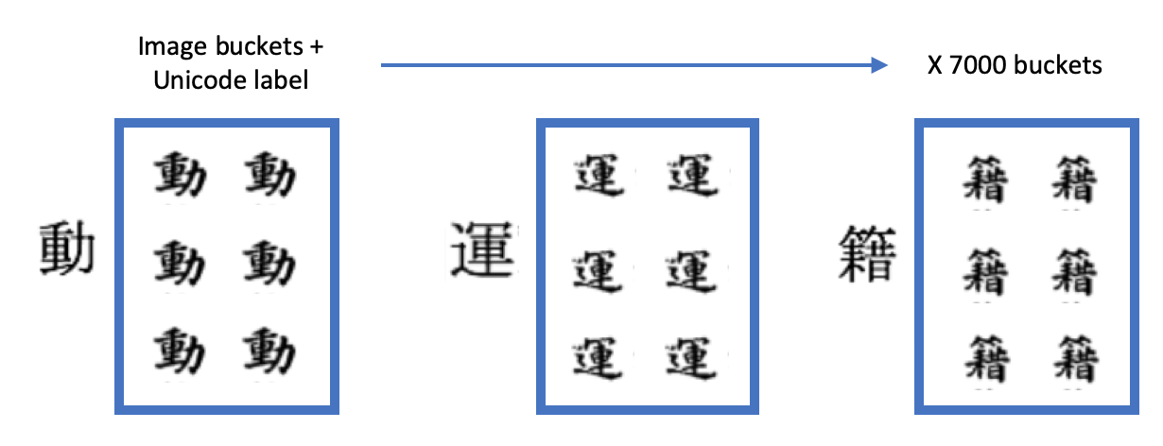
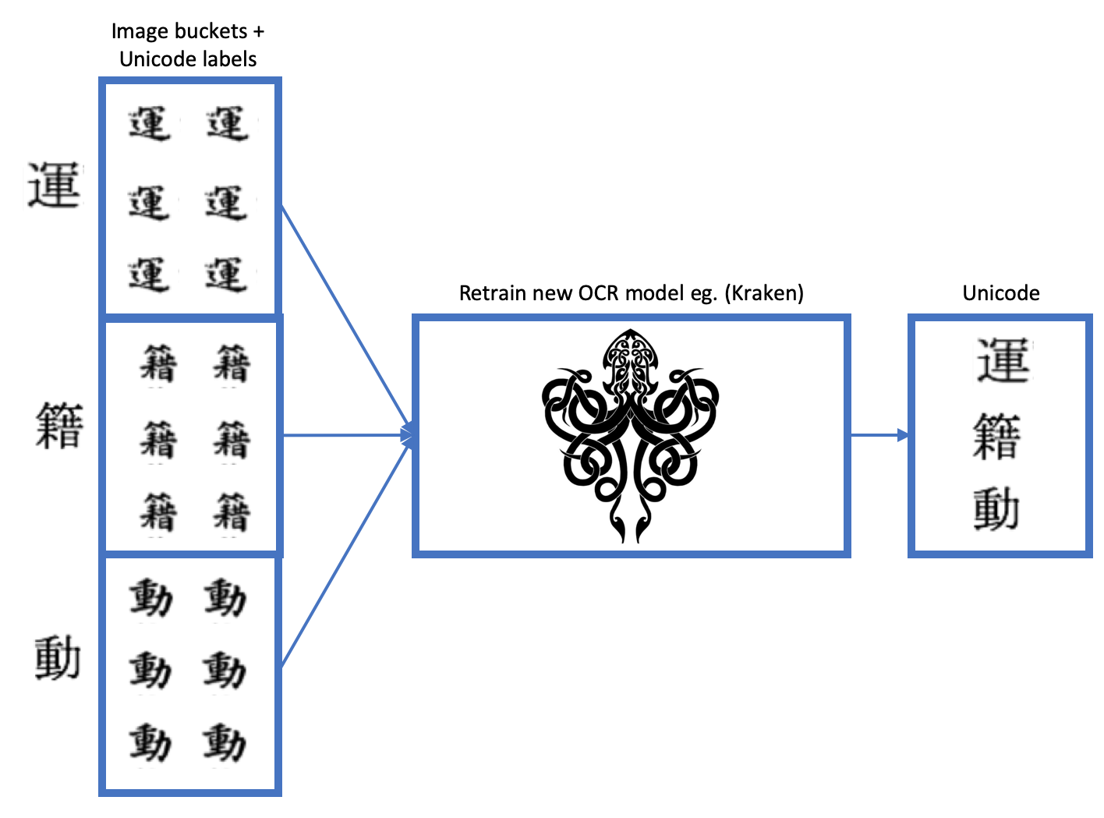
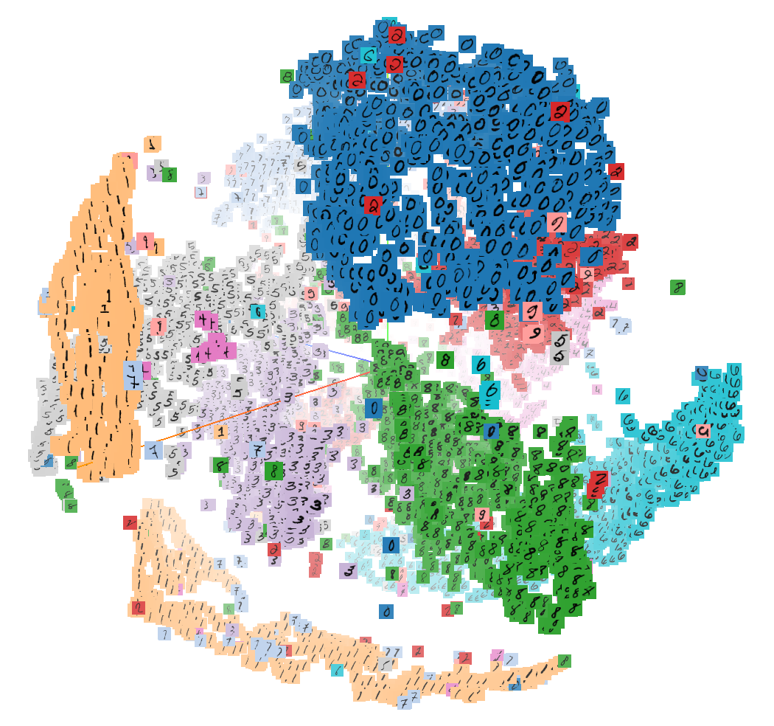
Proposed Solution
Effective Human-in-the-loop Correction
A human-in-the-loop user experience to enable a language expert to validate the transcription accuracy efficiently and enable us to retrain a new model with an accurate set of labels for the corpus.
1
3
1. Extracting initial training data and labels using OCR classifier
4. Design user interface using image grid projection of clusters for easy filtering
4
2. Categorise all image buckets with corresponding Unicode label
2
3. Use dimensionality reduction and clustering
to visually explore buckets
5. Use image buckets with Unicode label to retrain a new model

Slide 5
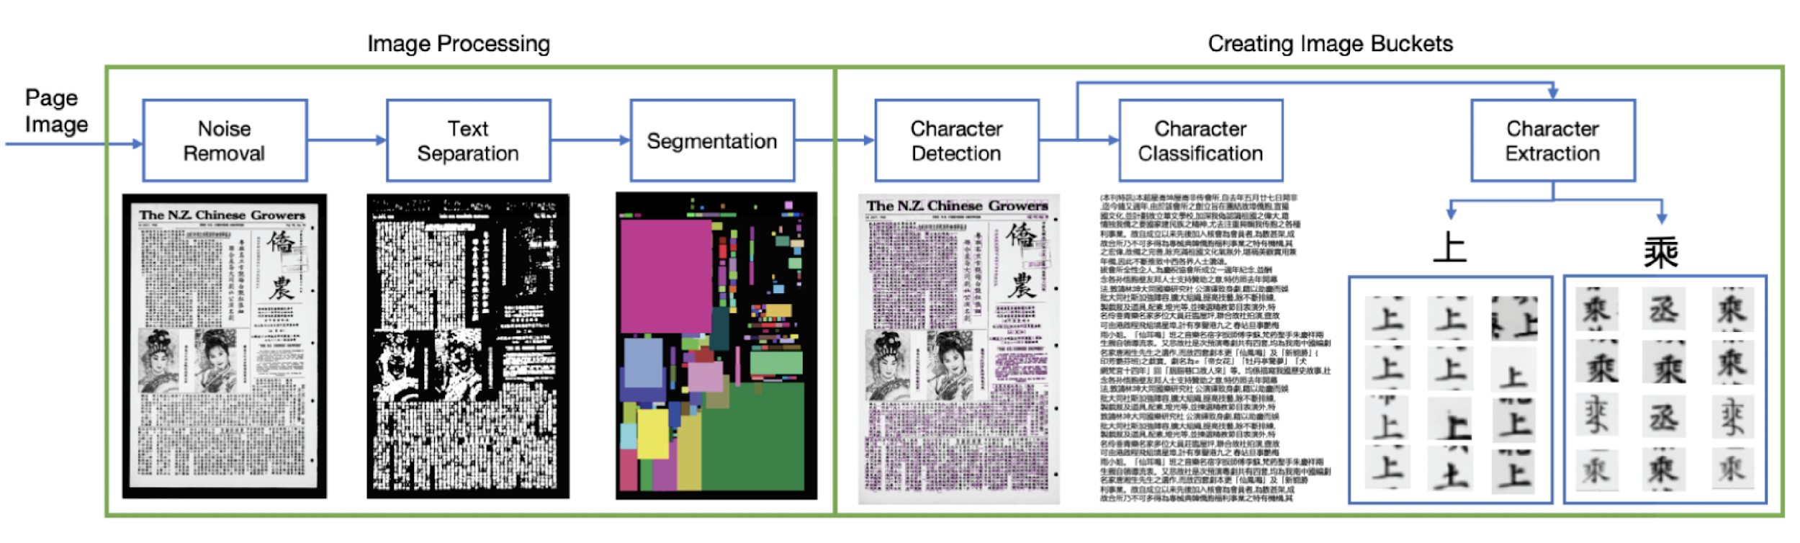
Part 1: Image Processing
Character Image Bucket Extraction Pipeline Design

Slide 6
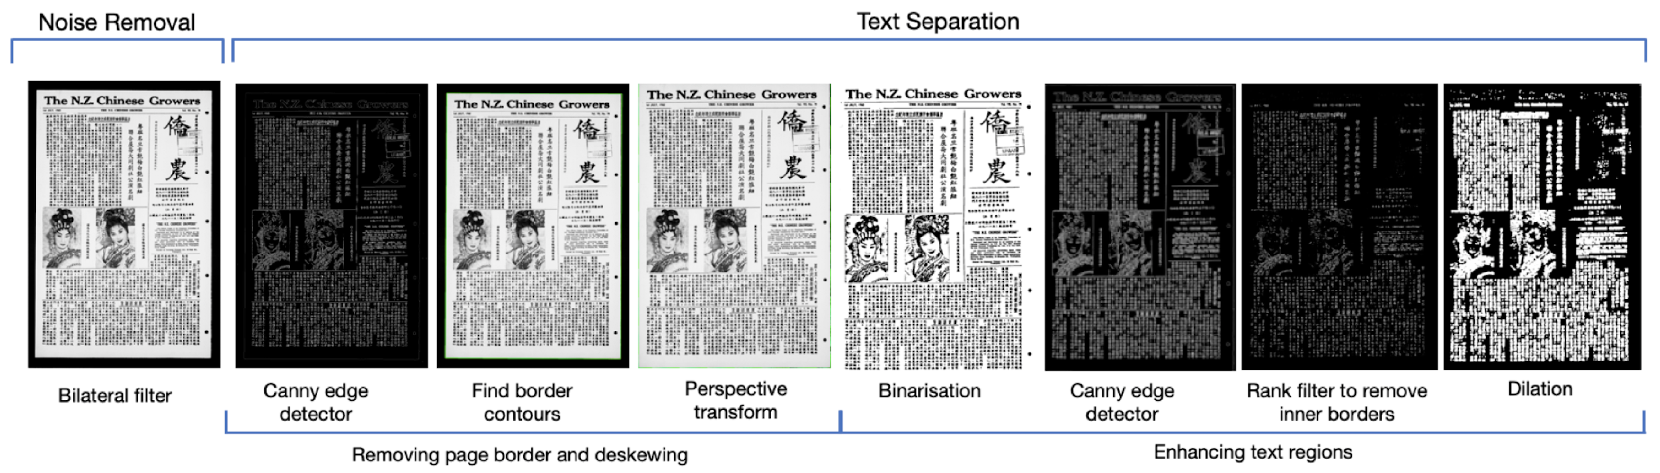
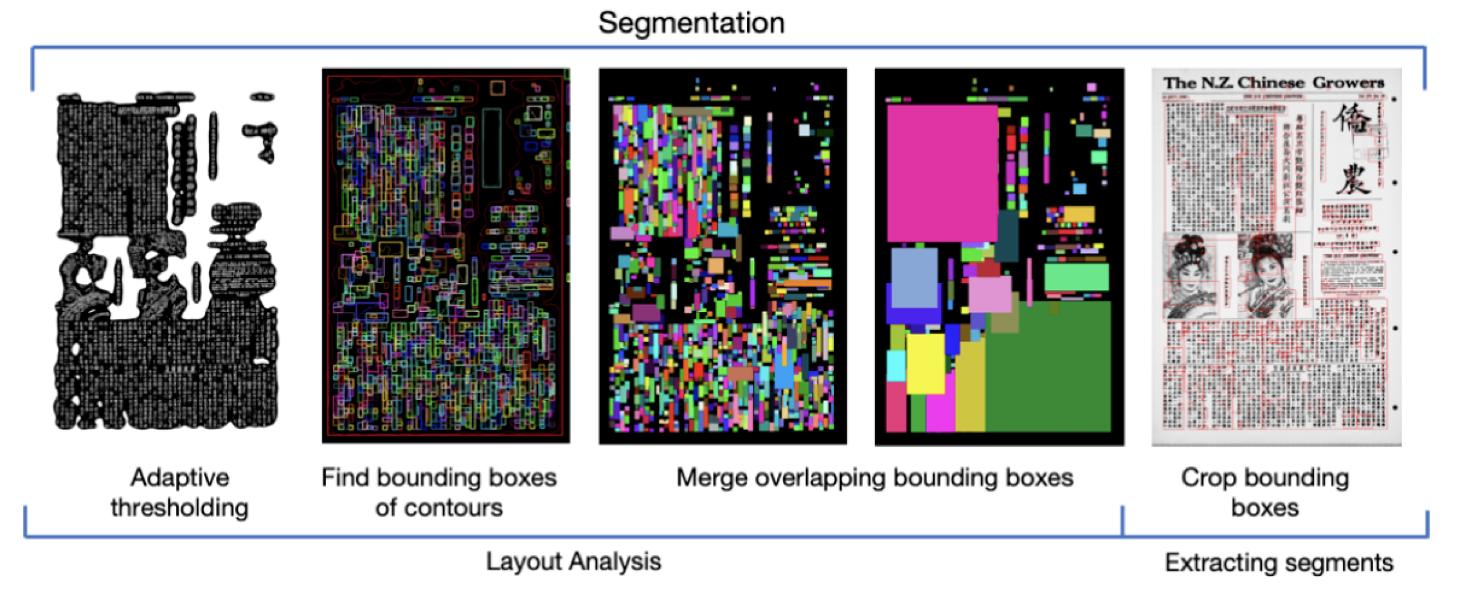
Part 1: Image Processing
Image Processing Pipeline Design

Slide 7
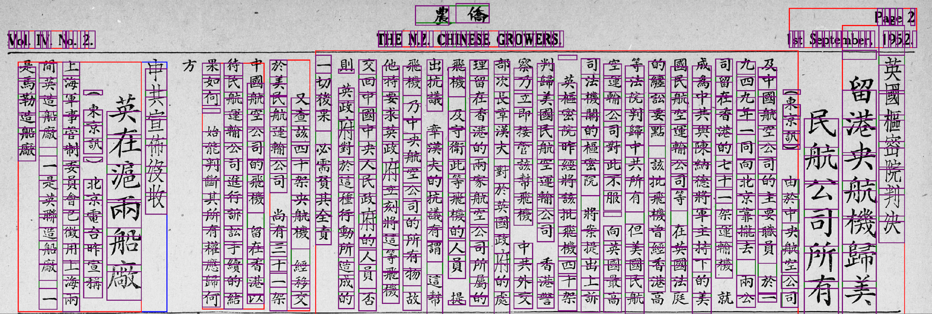
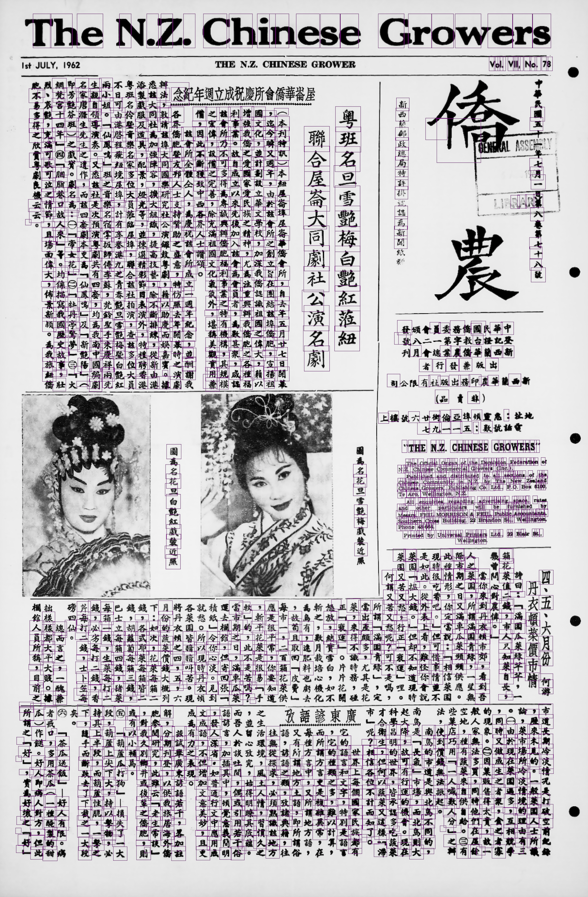
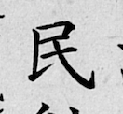
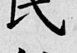
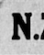
Part 1: Image Processing
Creating Image Buckets: Correcting Bounding Boxes
1
4
Detect characters with Google Vision API
2
3
Cleaning noisy detections; remove if -
If confidence < 0.50
Smaller than 28x28 (MNIST size)
No contours found in bounding box
If character bounding box area
< 10% total bounding box area
CJK and eng –
Grow bounding boxes until at least 20px padding either side
and crop square
Crop with fixed bounding boxes and save to labelled bucket
Punctuation - Fill into square image

Slide 8
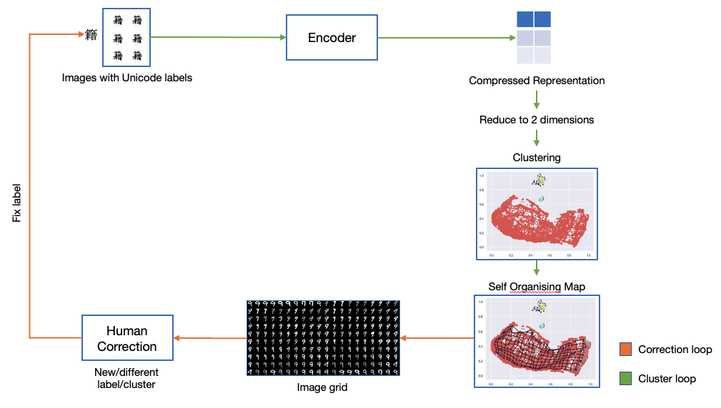

Part 2: Machine Learning Pipeline
Overview

Slide 9
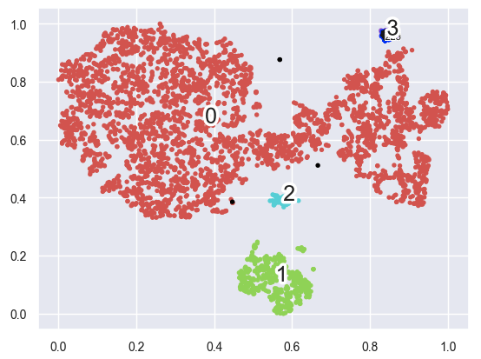
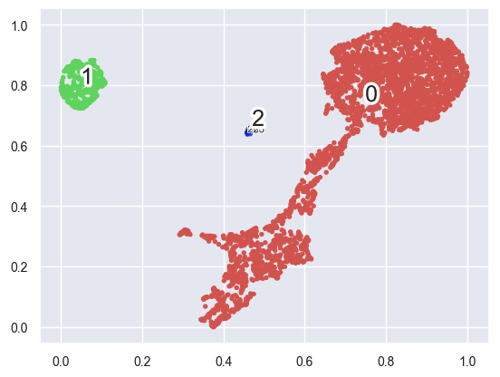
Part 2: Machine Learning Pipeline
Dimensionality Reduction and Clustering
T-SNE with HDBSCAN – 4260 images
Min Cluster Size=10
4 clusters found
17.02s (avg 3 runs)
UMAP with HDBSCAN – 4260 images
Min Cluster Size=10
3 clusters found
6.89s (avg 3 runs)

Slide 10
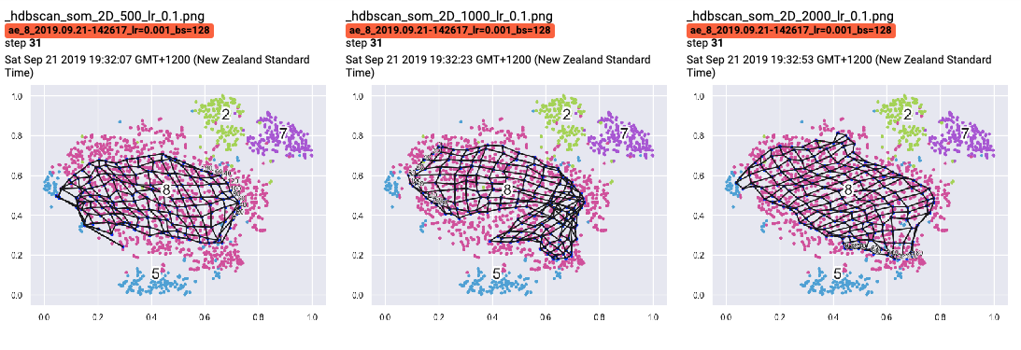
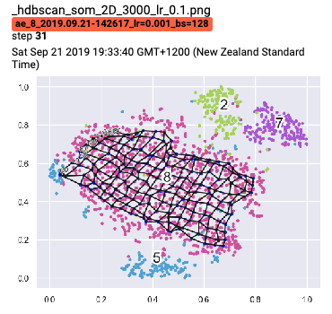
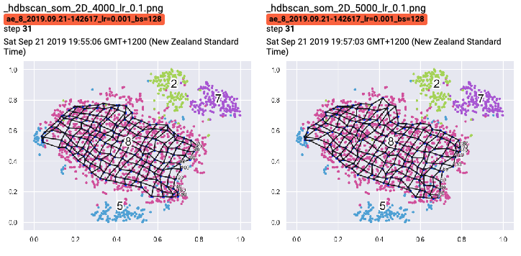
Part 2: Machine Learning Pipeline
Self Organising Map
Self Organising Map with learning rate = 0.1 for 500-5000 iterations on FilteredMNIST

Slide 11
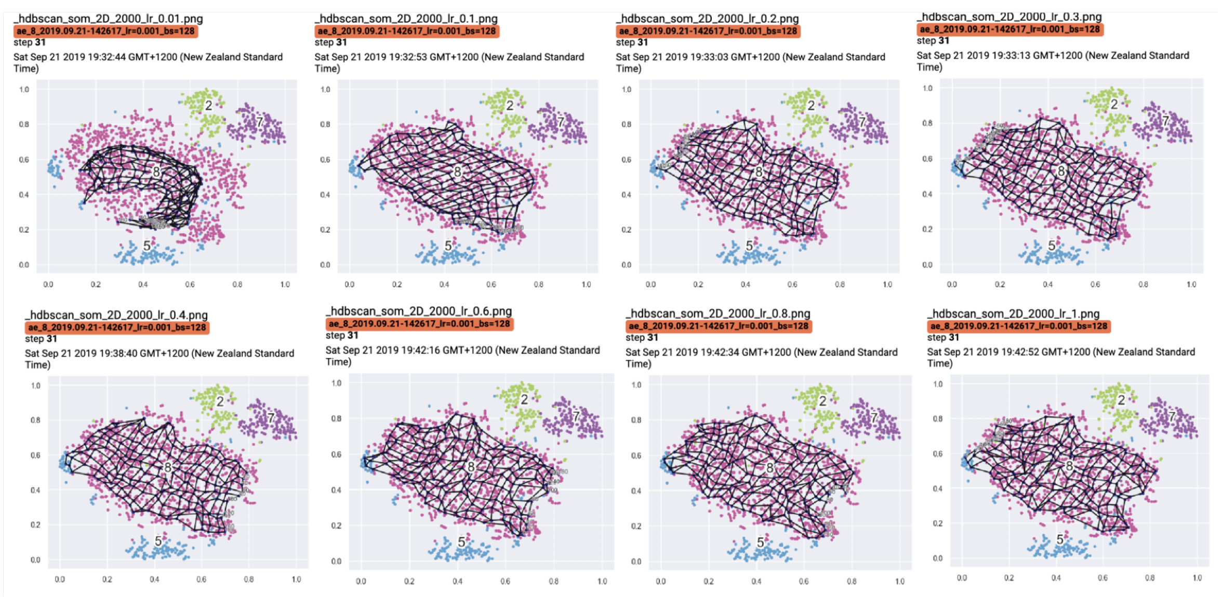
Part 2: Machine Learning Pipeline
Self Organising Map
Self Organising Map 2000 iterations over range of learning rates 0.01 to 1

Slide 12
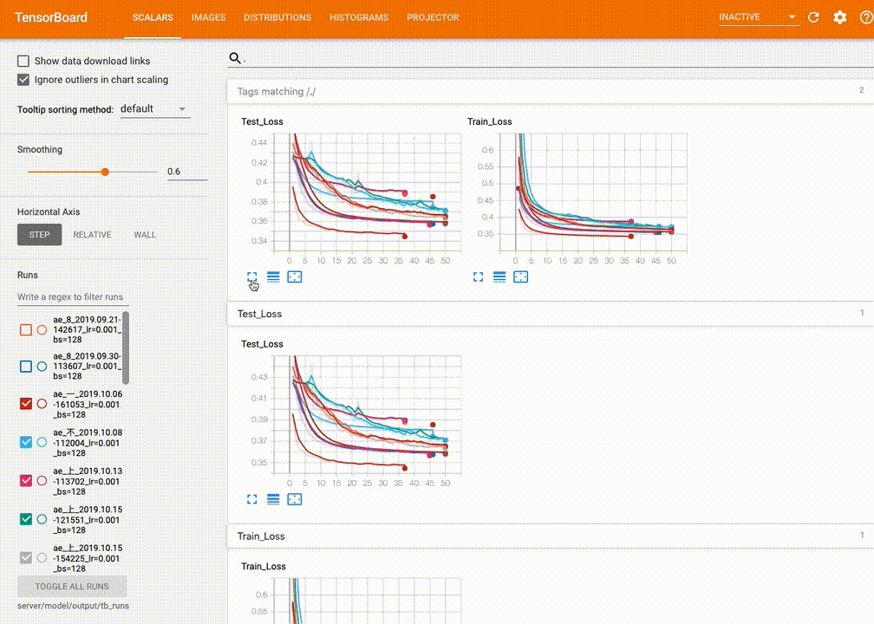
Part 2: Machine Learning Pipeline
Tensorboard Integration

Slide 13
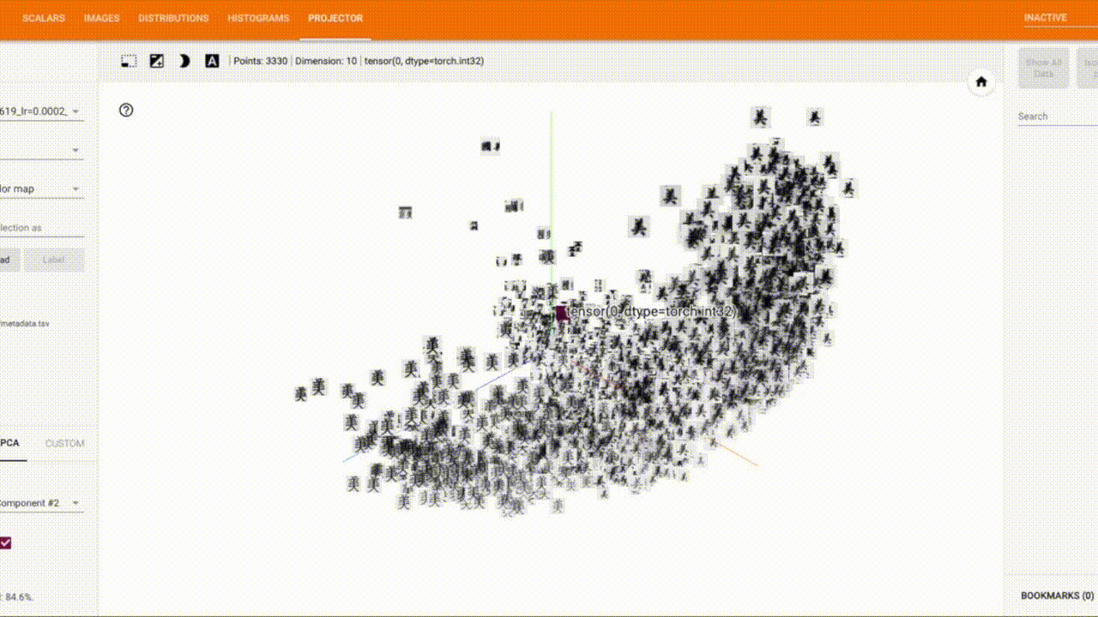
Part 2: Machine Learning Pipeline
Tensorboard Integration: Embedding Projector

Slide 14
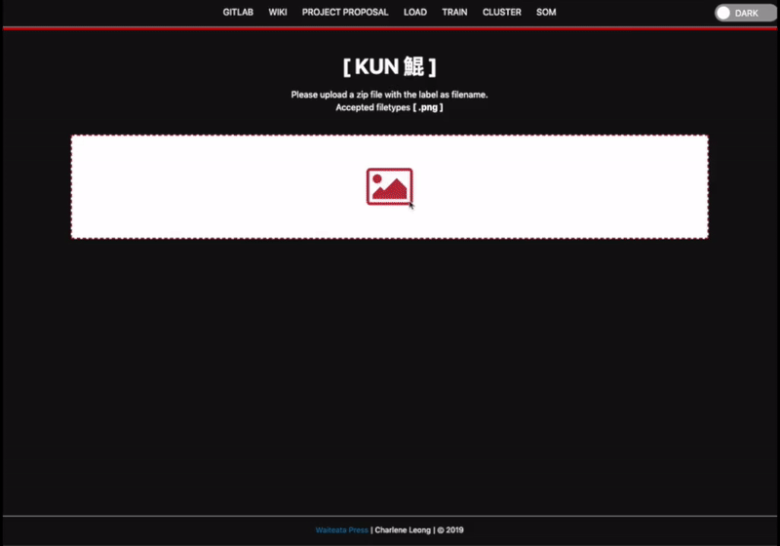
Part 3: Web Application
User Interface: Training Pipeline

Slide 15
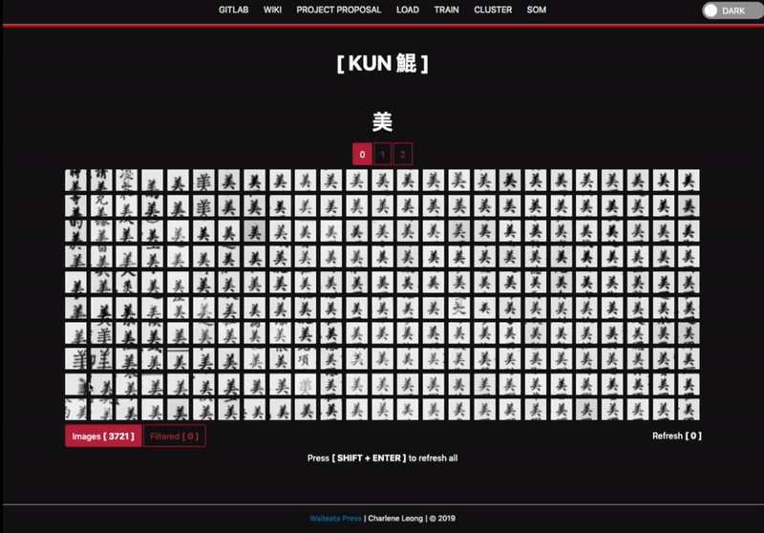
Part 3: Web Application
User Interface: Image Grid

Slide 16
Supplementary Slides

Slide 17
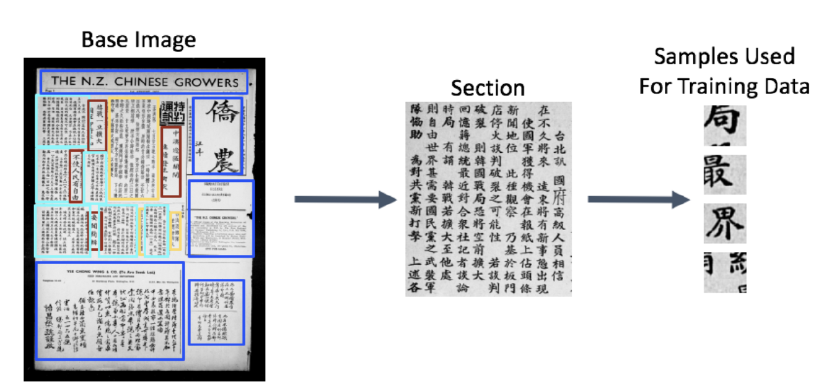
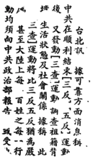
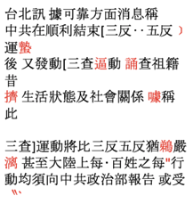
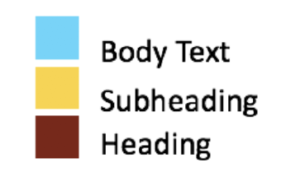

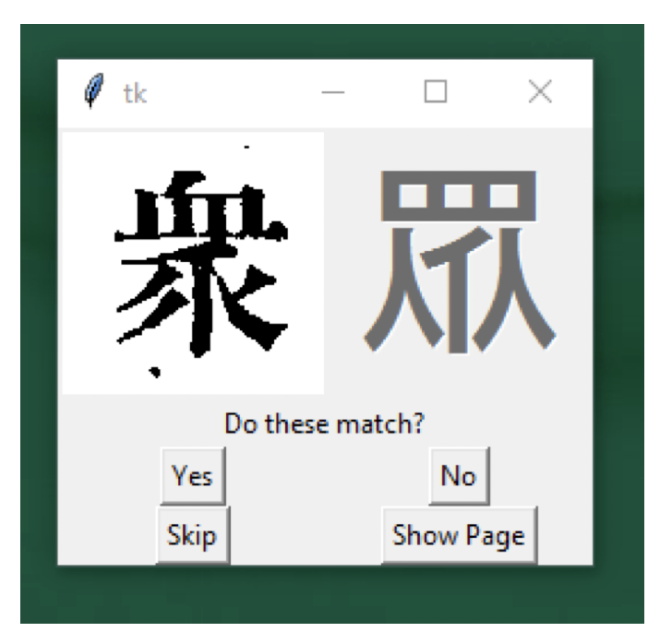

Project History
Qilin | Tesseract | Manual Consultation
1. Extracting Samples for Training Data
2. Extracting labels with Tesseract
3. Character Checker
Challenges –
inconsistency and disfiguration in the printed characters due to deterioration of the types over time
trouble translating different fonts and trouble recognising variants of characters
manual consultation of unclassified or misclassified characters a very time-intensive task.

Slide 18
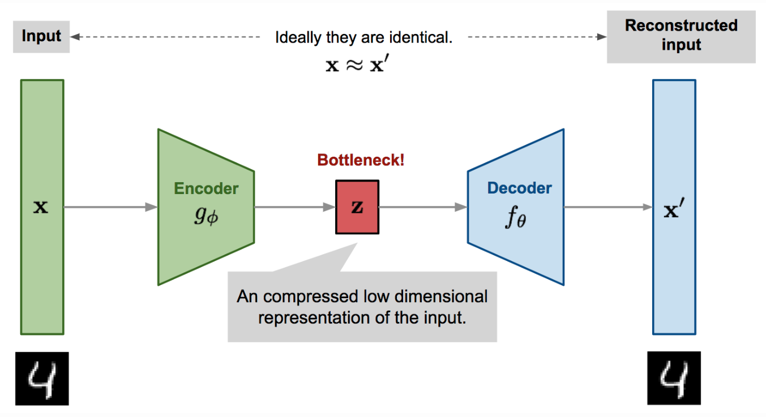
Part 2: Machine Learning Pipeline
Autoencoder

Slide 19
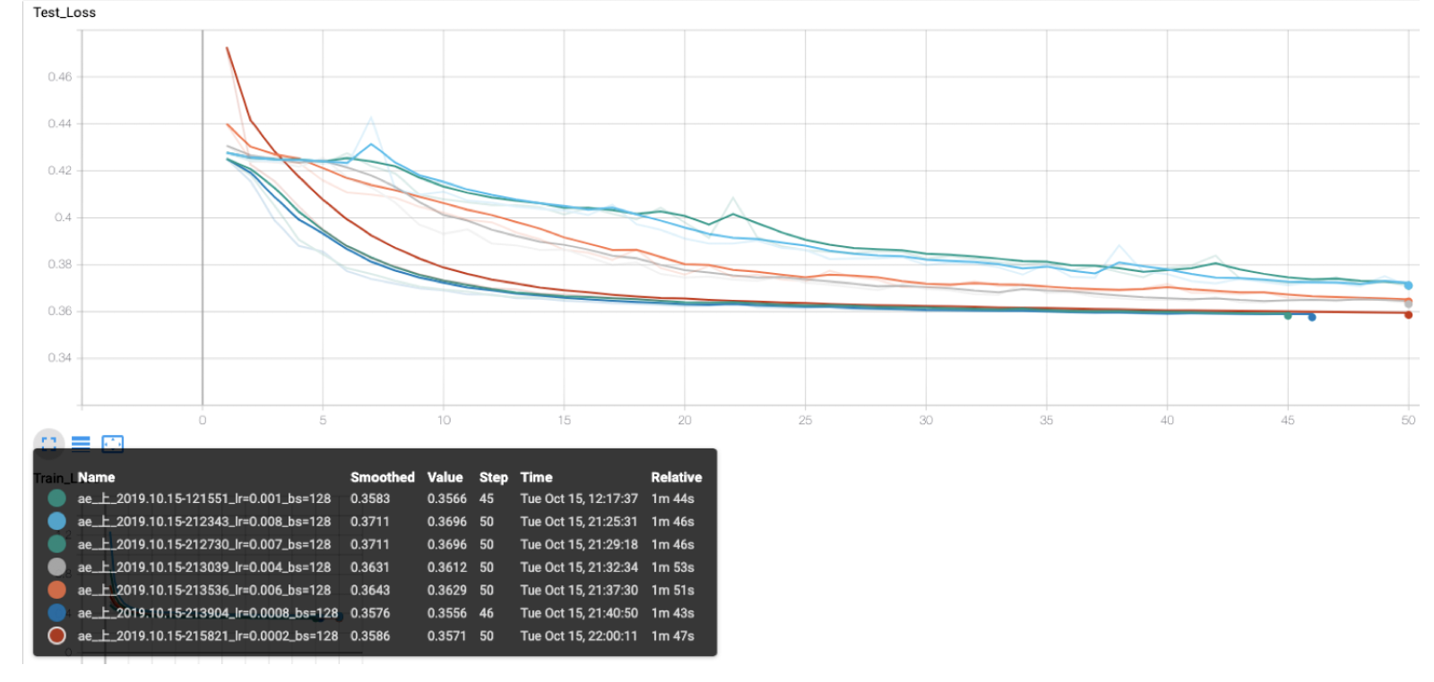
Part 2: Machine Learning Pipeline
Autoencoder

Slide 20
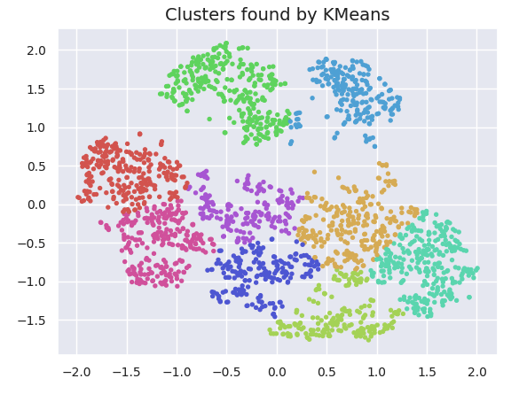
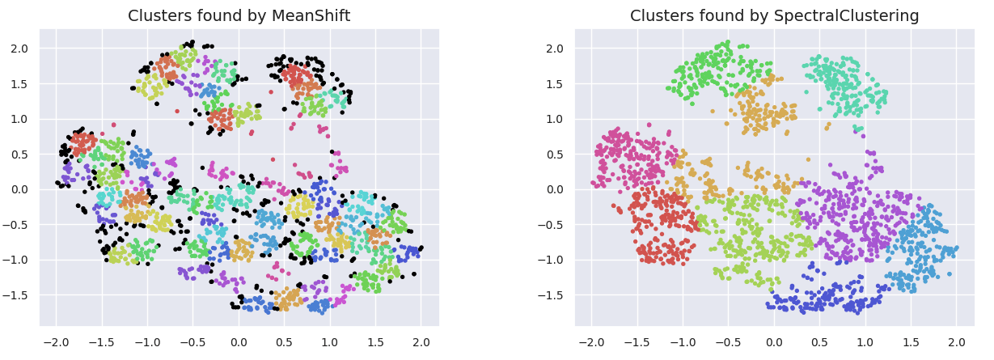
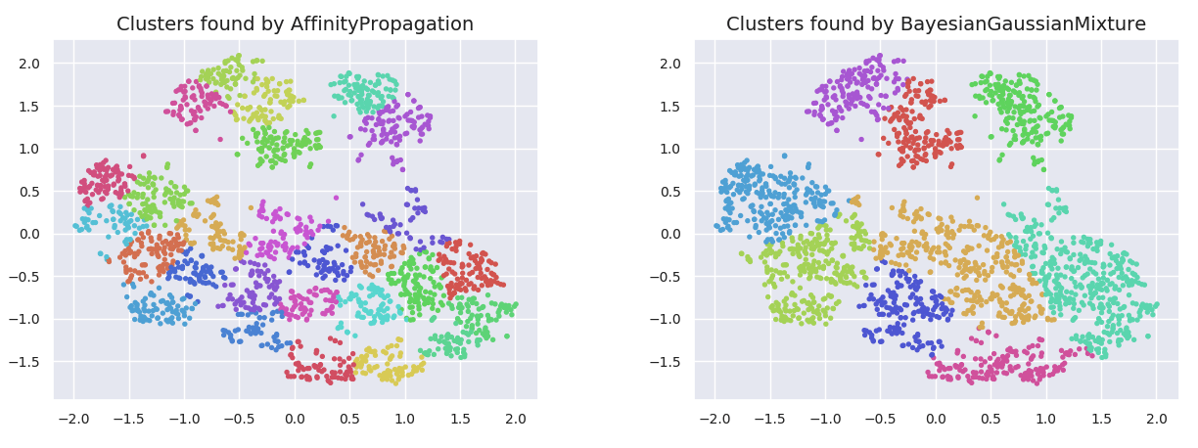
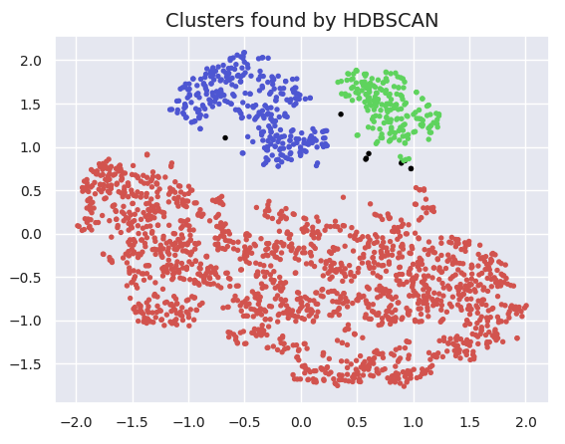
Part 2: Machine Learning Pipeline
Clustering

Slide 21
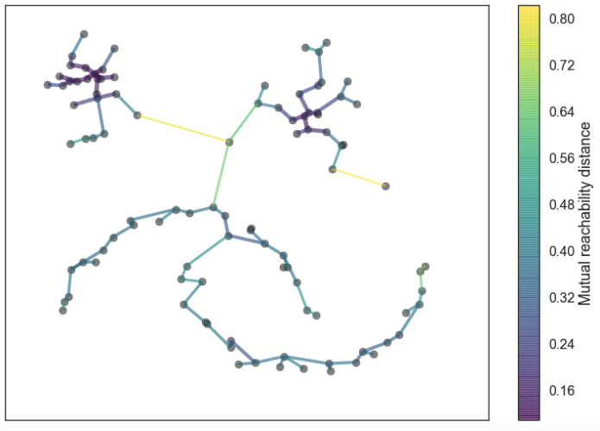


Part 2: Machine Learning Pipeline
HDBSCAN Clustering
Builds a minimum spanning tree
of distance weighted graph
Build cluster hierarchy of connected components
Condense the cluster tree based on minimum cluster size
and extract clusters

Slide 22




Part 2. Machine Learning Pipline
Clustering – Minimum Cluster Size
Min cluster size=10, 7 clusters found, 17.52s
Min cluster size=15, 3 clusters found, 19.16s
T-SNE with HDBSCAN – 3326 images
Min cluster size=10, 50 clusters found, 7.09s
Min cluster size=15, 5 clusters found, 7.66s
UMAP with HDBSCAN – 3326 images

Slide 23

Part 3: Web Application
Component Architecture

Slide 24

Part 3. Web Application
Select Images

Slide 25

Part 2: Machine Learning Pipeline
Self Organising Map and Image Grid
Self Organising Map with learning rate = 0.001 for 500 iterations in update mode

Slide 26


Part 3. Web Application
Database Schema

Slide 27

Part 3. Web Application
Database Schema

